Slide 1
Financial Management
Meaning & Role

Slide 2
Finance : Definition
Finance can be defined as the art and science of managing money.
Finance is concerned with the
process,
institutions,
markets, and
instruments
involved in the transfer of money among individuals, businesses, and governments

Slide 3
Basic Areas Of Finance
Corporate Finance (Business Finance)
Investments
Financial Institutions
International Finance

Slide 4
Why Study Finance?
Marketing
Budgets, marketing research, marketing financial products
Accounting
Dual accounting and finance function, preparation of financial statements
Management
Strategic thinking, job performance, profitability
Personal finance
Budgeting, retirement planning, college planning, day-to-day cash flow issues

Slide 5
Business Finance
Some important questions that are answered using finance
What long-term investments should the firm take on?
Where will we get the long-term financing to pay for the investments?
How will we manage the everyday financial activities of the firm?

Slide 6
Financial Management Decisions
Capital budgeting
What long-term investments or projects should the business take on?
Capital structure
How should we pay for our assets?
Should we use debt or equity?
Working capital management
How do we manage the day-to-day finances of the firm?
Notes:
Provide some examples of capital budgeting decisions, such as what product or service the firm will sell, should old equipment be replaced with newer, more advanced, equipment, etc.
Be sure to define debt and equity.
Provide some examples of working capital management issues, such as: whom to grant credit, how much inventory should be carried, when should suppliers be paid, etc.

Slide 7
Financial Management: Definition
Financial Management means
planning,
organizing,
directing and
controlling the financial activities of the enterprise.
It means applying general management principles to financial resources of the enterprise.
For eg. procurement and utilization of funds of the enterprise.

Slide 8
Financial Management: Elements
Investment decisions includes investment in fixed assets (called as capital budgeting). Investment in current assets are also a part of investment decisions called as working capital decisions.
Financial decisions - They relate to the raising of finance from various resources which will depend upon decision on type of source, period of financing, cost of financing and the returns thereby.
Dividend decision - The finance manager has to take decision with regards to the net profit distribution. Net profits are generally divided into two:
Dividend for shareholders- Dividend and the rate of it has to be decided.
Retained profits- Amount of retained profits has to be finalized which will depend upon expansion and diversification plans of the enterprise.

Slide 9
Financial Management : Objectives
Financial management is generally concerned with procurement, allocation and control of financial resources of a concern.
The objectives can be- To ensure regular and adequate supply of funds to the concern.
To ensure adequate returns to the shareholders which will depend upon the earning capacity, market price of the share, expectations of the shareholders.
To ensure optimum funds utilization. Once the funds are procured, they should be utilized in maximum possible way at least cost.
To ensure safety on investment, i.e, funds should be invested in safe ventures so that adequate rate of return can be achieved.
To plan a sound capital structure-There should be sound and fair composition of capital so that a balance is maintained between debt and equity capital.

Slide 10
Financial Management : Functions
Estimation of capital requirements
Determination of capital composition
Choice of sources of funds
Investment of funds
Disposal of surplus
Management of cash
Financial controls

Slide 11
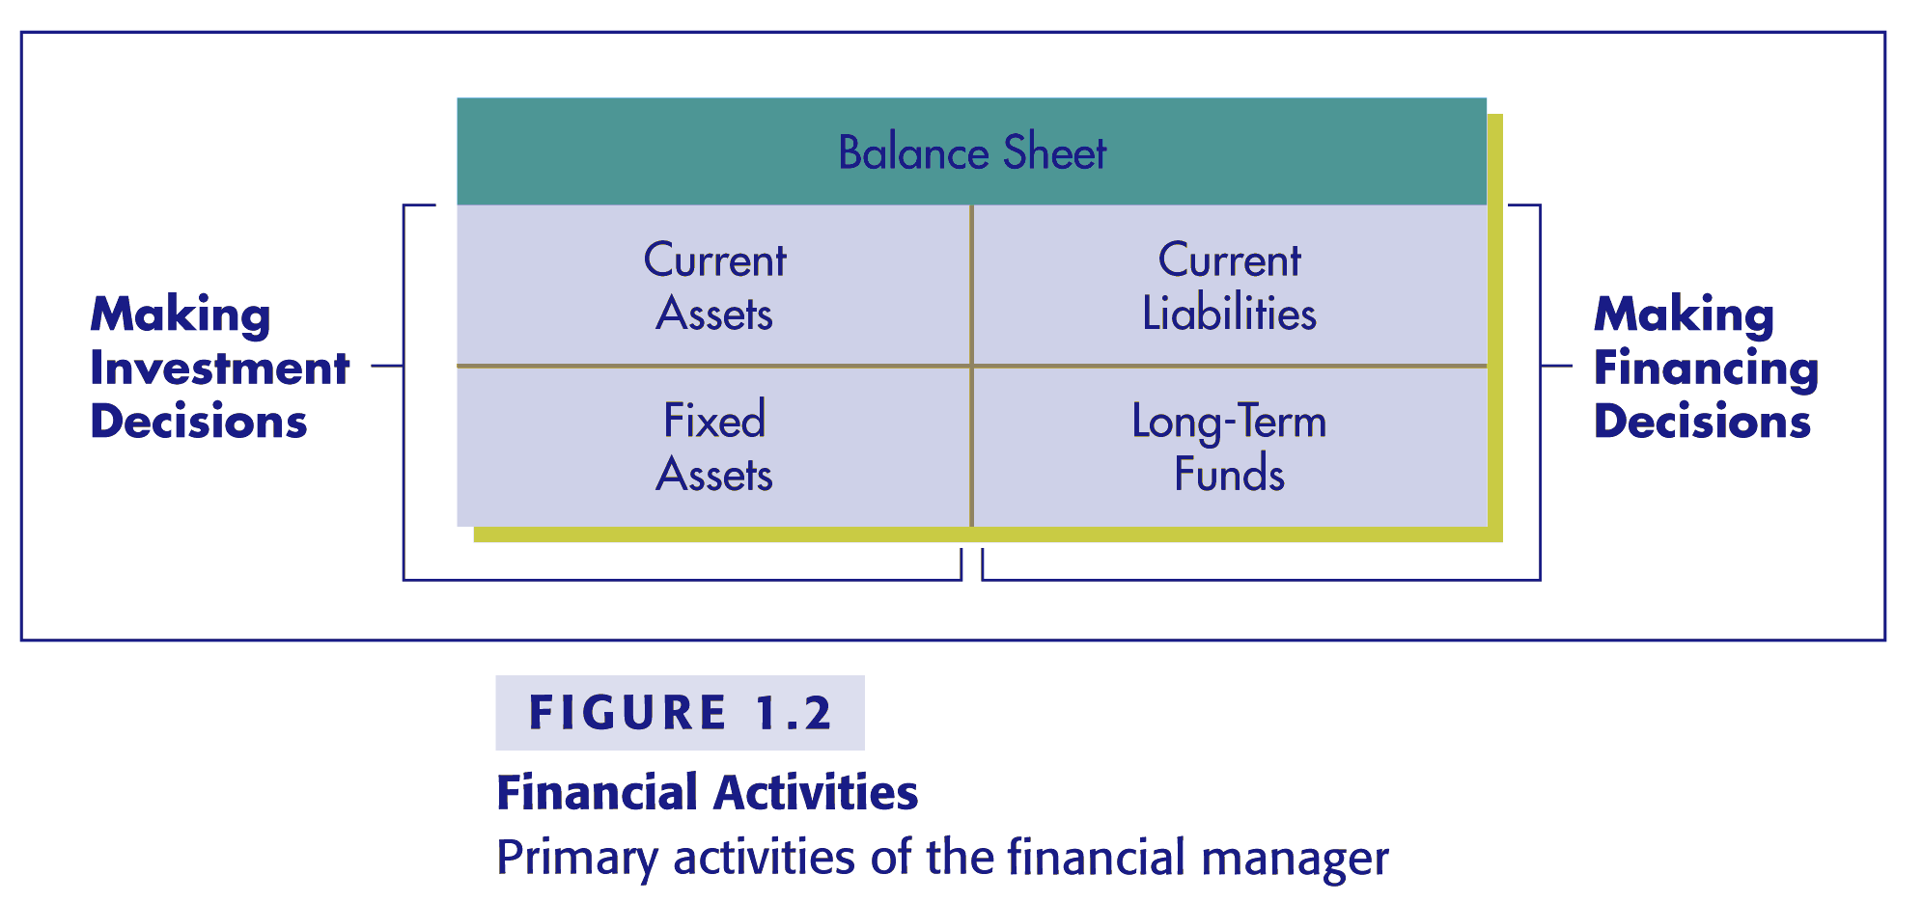
Primary Activities of the Financial Manager

Slide 12
RATIO ANALYSIS: Meaning, Advantages, Limitations, Types of Ratios & Usefulness

Slide 13
Ratio Analysis: Meaning
Ratio analysis is a process of determining and interpreting relationships between the items of financial statements to provide a meaningful understanding of the performance and financial position of an enterprise.
Ratio analysis is an accounting tool to present accounting variables in a simple, concise, intelligible and understandable form.
As per Myers “Ratio analysis is a study of relationship among various financial factors in a business”

Slide 14
Ratio Analysis: Objectives
The objective of ratio analysis is to judge the earning capacity, financial soundness and operating efficiency of a business organization. The use of ratio in accounting and financial management analysis helps the management to know the profitability, financial position and operating efficiency of an enterprise.

Slide 15
Ratio Analysis: Advantages
Useful in analysis of financial statements: Bankers, investors, creditors, etc analysis balance sheets and profit and loss accounts by means of ratios.
Useful in simplifying accounting figures:
Accounting ratio simplifies summarizes and systematizes a long array of accounting figures to make them understandable.
In the words of Biramn and Dribin, “ Financial ratios are useful because they summarize briefly the results of detailed and complicated computation”

Slide 16
Ratio Analysis: Advantages
Useful in judging the operating efficiency of business: Accounting Ratio are also useful for diagnosis of the financial health of the enterprise. This is done by evaluating liquidity, solvency, profitability etc.
Useful for forecasting: Helpful in business planning, forecasting.
Useful in locating the weak spots:
Locating the weak spots in the business even though the overall performance may quite good. For example if the firm finds that the increase in distribution expense is more than proportionate to the results achieved, these can be examined in detail and depth to remove any wastage that may be there.

Slide 17
Ratio Analysis: Advantages
Useful in Inter-firm and Intra-firm comparison:
A firm would like to compare its performance with that of other firms and of industry in general. The comparison is called inter-firm comparison. If the performance of different units belonging to the same firm is to be compared, it is called intra-firm comparison.

Slide 18
Ratio Analysis: Limitations
False Results: If Financial Statements are not correct Financial Ratio Analysis will also be correct.
Different meanings are put on different terms: Elements and sub-elements are not uniquely defined. An enterprise may work out ratios on the basis of profit after Tax and interest while others work on profit before interest and Tax.
Not comparable: if different firms follow different
accounting Policies.

Slide 19
Ratio Analysis: Limitations
Affect of Price level changes
Ignores qualitative factors
Ratios may be worked out for insignificant and unrelated figures.
Difficult to evolve a standard Ratio
Window Dressing
Personal Bias

Slide 20
Types of Ratios
Liquidity Ratio
Solvency Ratio
Activity Ratio
Profitability Ratio
Coverage Ratio

Slide 21
Usefulness of Ratio: Liquidity Ratio (Short Term Solvency)
It measures the short-term solvency, i.e., the firm’s ability to pay its current dues. They comprise of Current Ratio and Liquid Ratio.
Current Ratio = Current Assets/Current Liabilities
Usefulness: As a normal rule current assets should be twice the current liabilities. (2:1 is satisfactory)
Low ratio indicates inadequacy of the enterprise to meet its current liabilities and inadequate working Capital.
High Ratio is an indication of inefficient utilization of funds.

Slide 22
Usefulness of Ratio: Liquid Ratio or Quick Ratio or Acid Test Ratio
It is a relationship of liquid assets with current liabilities and is computed to assess the short- term liquidity of the enterprise in its correct form.
Liquidity Ratio = Liquid assets or quick assets/ Current Liabilities
Quick assets= Current assets – (stock + Prepaid Expenses)
A quick ratio of 1:1 is usually considered favorable, since for every rupee of current liabilities, there is a rupee of current assets.
A high liquidity ratio compared to current ratio may indicate
under stocking while a low liquidity ratio indicated overstocking.

Slide 23
Example: Liquid Ratio or Quick Ratio or Acid Test Ratio
Example 1: A company has following assets and liabilities at the year ended December 31, 2009:
Cash$34,390 , Accounts Receivable 56,200 Prepaid Insurance 9,000 Total Current Assets 111,590, Total Current Liabilities 73,780 Calculate quick ratio (acid test ratio).
Solution Quick ratio = ( 34,390 + 56,200 ) / 73,780 = 1.23 (under stocking )

Slide 24
Usefulness of Ratio: Financial Structure/Solvency Ratio
The term ‘solvency’ implies ability of an enterprise to meet its indebtedness and thus conveys an enterprise’s ability to meet its
long - term obligations.
Important solvency ratios are:
Debt-Equity Ratio;
Total assets to Debts Ratio and
Total assets to Proprietary Ratio

Slide 25
Usefulness of Ratio: Financial Structure/Solvency Ratio
Debt- equity Ratio = Debt (long-term loans)/
Equity (shareholders’ Funds)
Higher Ratio indicates risky financial position
lower ratio indicates safe financial position.
Acceptable Debt-Equity Ratio is 2:1 which means debt can be twice the equity.
This ratio is significant to access the soundness of long –term financial position. It also indicates the extent to which firm depends upon outsiders for its existence. It portrays the proportion of total funds acquired by a firm by way of loans.

Slide 26
Usefulness of Ratio: Financial Structure/Solvency Ratio
Total Assets to Debt Ratio = Total assets/ Long Term Debts
Ideal Ratio is 2:1
Proprietary Ratio = Proprietor’s funds or share holders’ funds/ Total assets (excluding fictitious assets)
Higher the ratio the better it is for all concerned.

